Slide 1
ETL/Datawarehouse Testing

Slide 2
Agenda
Introduction to Data Warehousing and ETL What is ETL?
Key Objectives of ETL Testing
ETL Workflow
What is Datawarehouse?
Data Warehouse vs Data Mart - Difference
Datawarehouse Architecture
ETL Testing Types
ETL Testing Process
Facts and Dimensions
Star Schema
Snowflake Schema
SCD types
ETL Loading Strategies
ETL Testing Challenges
Best Practices

Slide 3
Introduction to Data Warehousing and ETL
Data Warehousing:
A Data Warehousing (DW) is process for collecting and managing data from varied sources to provide meaningful business insights.
A data warehouse is a large, centralized repository that stores data from different sources.
It is designed for analytical processing and decision-making support.
ETL (Extract, Transform, Load):
ETL is the process of moving data from multiple sources into the data warehouse.
Extract: Pulling data from various source systems.
Transform: Converting the extracted data into a usable format (cleaning, aggregating, etc.).
Load: Storing the transformed data into the data warehouse.

Slide 4
Key Objectives of ETL Testing
Data Integrity: Ensuring that the data in the source system matches the data in the data warehouse.
Data Quality: Ensuring that the transformation rules are correctly implemented, and no data is corrupted during the ETL process.
Performance: Verifying that ETL jobs perform efficiently, especially with large data sets, and checking for bottlenecks or failures.
Error Handling: Ensuring that errors during the ETL process are caught and logged properly.
Compliance: Verifying that the data adheres to business rules and regulatory requirements.

Slide 5
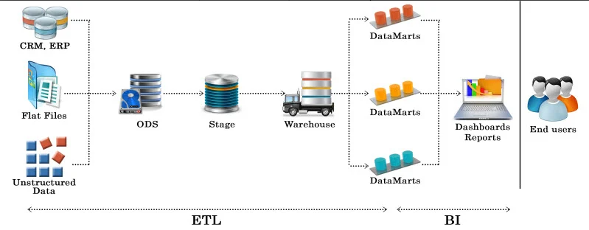
ETL Workflow

Slide 6
What is Datawarehouse?
A Data Warehouse works as a central repository where information arrives from one or more data sources.
Data may be:
Structured
Semi-structured
Unstructured data
Types of Datawarehouse:
Enterprise Data warehouse(EDW)
Operational data store
Data mart

Slide 7
Data Warehouse vs Data Mart - Difference
Parameter | Datawarehouse | Data Mart
Definition | A Data Warehouse is a large repository of data collected from different organizations or departments within a corporation | A data mart is an only subtype of a Data Warehouse. It is designed to meet the need of a certain user group.
Objective | The main objective of Data Warehouse is to provide an integrated environment and coherent picture of the business at a point in time. | A data mart mostly used in a business division at the department level.
Designing | The designing process of Data Warehouse is quite difficult. | The designing process of Data Mart is easy.
Data Handling | Data warehousing includes large area of the corporation which is why it takes a long time to process it. | Data marts are easy to use, design and implement as it can only handle small amounts of data.
Size | The size of the Data Warehouse may range from 100 GB to 1 TB+. | The Size of Data Mart is less than 100 GB.

Slide 8
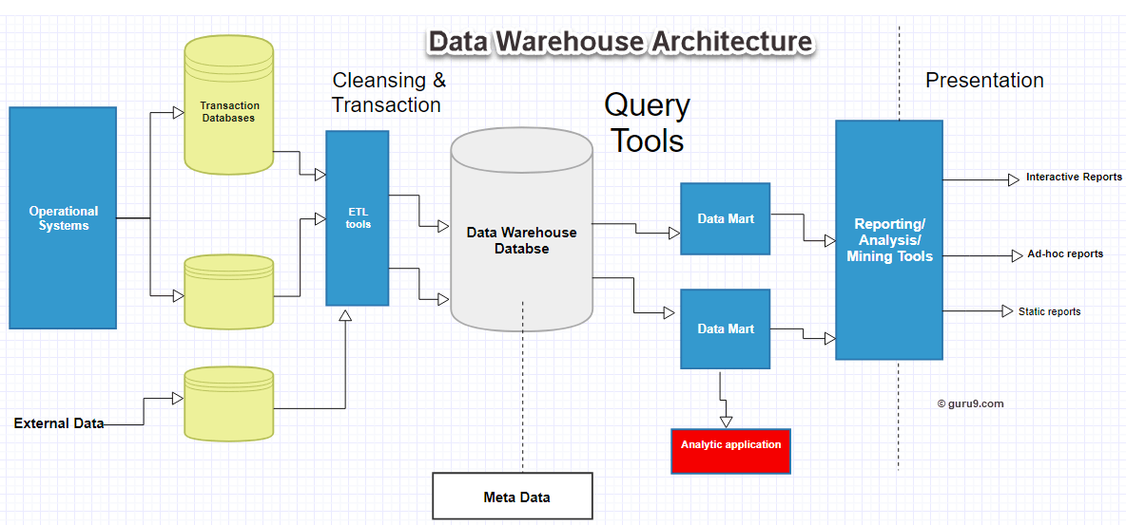
Datawarehouse Architecture

Slide 9
ETL Testing Types
Production Validation Testing
Table balancing or product reconciliation. It is performed on data before or while being moved into the production system in the correct order.
Source To Target Testing
Performed to validate the data values after data transformation.
Application Upgrade
Check data extracted from an older application or repository are exactly same as the data in a repository or new application.

Slide 10
Contd..
Metadata Testing:
Metadata testing includes testing of data type check, data length check and index/constraint check.
Data Transformation Testing:
Multiple SQL queries are required to be run for each and every row to verify data transformation standards.
Data Quality Testing:
Data Quality Tests includes syntax and reference tests. In order to avoid any error due to date or order number during business process Data Quality testing is done.
Data Completeness Testing:
Verify if all the expected data is loaded at the appropriate destination as per the predefined standards.

Slide 11
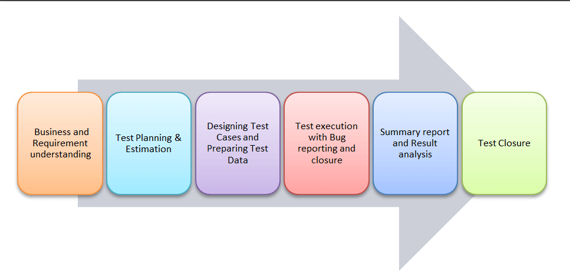
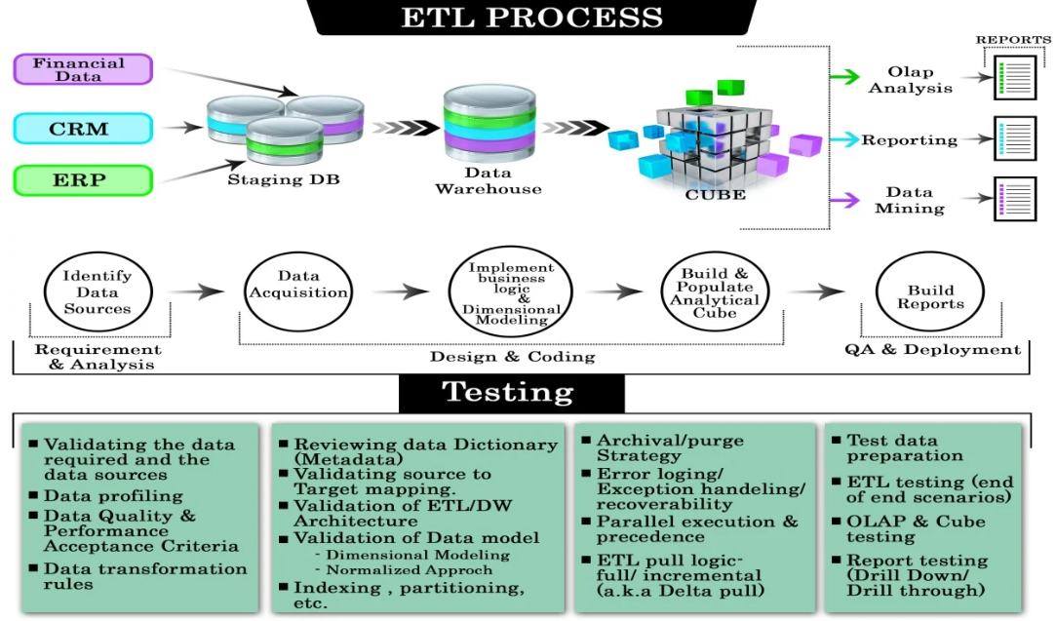
ETL Testing Process

Slide 12
Facts and Dimensions
Dimension Table contains:
Dimensions of fact
They are joined to Fact table via a foreign key
Dimension tables are de-normalized tables
Types of Dimension tables:-
Conformed Dimensions
Role-playing Dimensions
Slowly changing Dimensions
Junk Dimensions
Fact table contains:-
Measurements/Facts
Foreign key to dimension table
Types of Fact table:-
Additive
Semi-additive
Non-additive

Slide 13
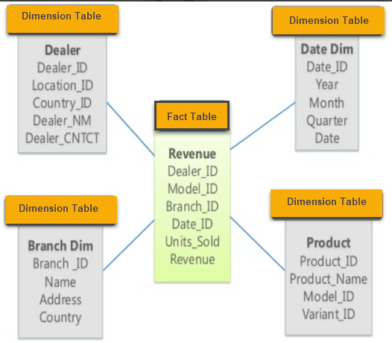
Star Schema

Slide 14
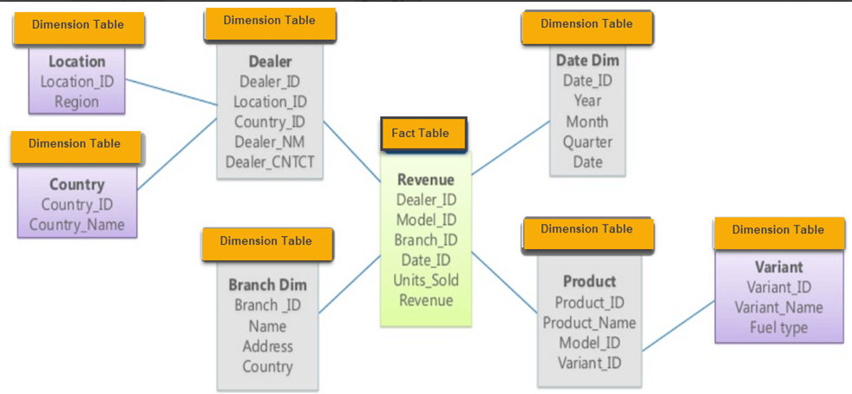
Snowflake Schema

Slide 15
SCD types
A Slowly Changing Dimension (SCD) is a dimension that stores and manages both current and historical data over time in a data warehouse.
It is considered and implemented as one of the most critical ETL tasks in tracking the history of dimension records

Slide 16
SCD Types Contd..
Type 0: Always retains original
Type 1 : Keeps latest data, old data is overwritten
Type 2 : Keeps the history of old data by adding new row
Type 3 : Adds new attribute to store changed value
Type 4 : Uses separate history table
Type 6 : combination of type 1, 2 and 3

Slide 17
ETL Loading Strategies
Full Load – Truncate and Load
Truncating the target table before loading new data (Staging Area)
Incremental Load
Incremental load is a process of loading data incrementally
Only new and changed data is loaded to the destination
Used to keep historical data
Uses Timestamps, Flags, Business key to fetch delta records

Slide 18

ETL Testing Challenges
Testers have no privileges to execute ETL jobs by their own
Volume and complexity of data are very huge
Incompatible and duplicate data
Loss of data during ETL process
Fault in business process and procedures
Trouble acquiring and building test data
Unstable testing environment
Missing business flow information

Slide 19
Best Practices
Make sure data is transformed correctly
Without any data loss and truncation projected data should be loaded into the data warehouse
Ensure that ETL application appropriately rejects and replaces with default values and reports invalid data
Ensure appropriate load occurs at each data layer

Slide 20
Contd..
Need to ensure that the data loaded in data warehouse within prescribed and expected time frames to confirm scalability and performance
Ensure records are updated as per appropriate Business Key in the target database tables
Ensure coding standards are in place while designing ETL mappings

Slide 21
Thanks!
Any questions?

